Slide 1
Computer Graphics
2D Transformation

Slide 2
Using JS Module
Modern javascript uses module to organize javascript projects
benefit :
Encapsulation and organization
Reusability
Maintainability
Dependency management
Scope control

Slide 3
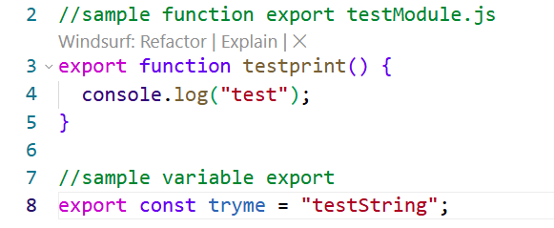
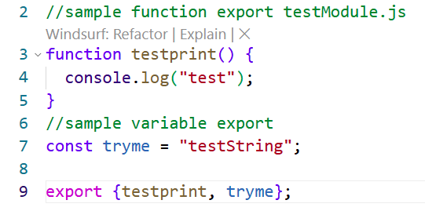
A simple js module
module can be a function, a class, or variable using the export keyword

Slide 4
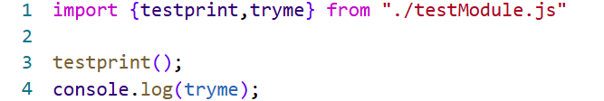
importing module
to import a module you can use import keyword from a script that is type = module

Slide 5
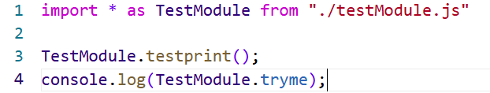
importing all in a module
you can use import * and add an alias

Slide 6
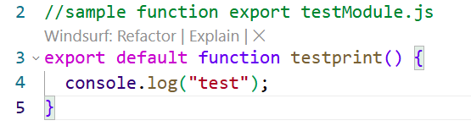

export default

Slide 7
Assignment
Change your library to a module

Slide 8
2D transformation
Translation
Rotation
Scale
Shear ?

Slide 9




Translasi
X' = X + Tx
Y' = Y + Ty

Slide 10

Penskalaan
X' = X . Sx
Y' = Y . Sy

Slide 11
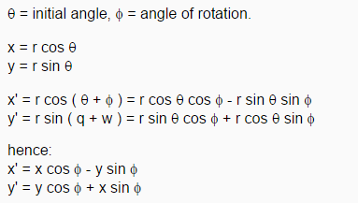
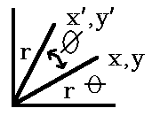
Rotasi

Slide 12
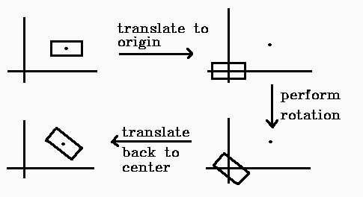
Fixed –Point rotation

Slide 13
Tugas Kelas
Implement :
Translasi
Rotasi
Scale
Fixed-point rotation
Fixed-point scale

